Slide 1
CpE 213 Digital System Design
Introduction to computer organization
1/19/2001

Slide 2
Overview
Homework discussion
  Groups of 3 or 4. Spokesperson report on a ‘controversial’ problem.
What’s this 8-bit stuff? I thought the Pentium was ‘IT’!
Computer organization - Gnome2
  bridge the gap between CpE111 and 213
  Learn how ‘von Neuman’ computers operate

Slide 3
Homework discussion
Divide into groups of 3-4
Introduce each other and select spokesperson
Identify a ‘controversial’ question and write on
  why it’s controversial
  your group’s ‘answer’
Spokesperson reports after 5 min
Include group member’s names and date on report and hand it in.
Notes:
This is an example of an ‘active learning’ session or brainstorm session. You should be prepared from working the problems to discuss those that may be a bit controversial. That means there are answers that are different from the one’s in the text. Questions 1, 7, 8, and 16 fall into this category. For example, the author says a 16-bit system is one with a 16 bit data bus. That would eliminate an early version of the 68000 and 8086 architecture (the 8088) that had internal 16-bit buses and registers but an 8 bit data bus. At the same time, it would rate newer processors as 64-bit because their data bus was that wide even though internal registers are still 32 bit.

Slide 4
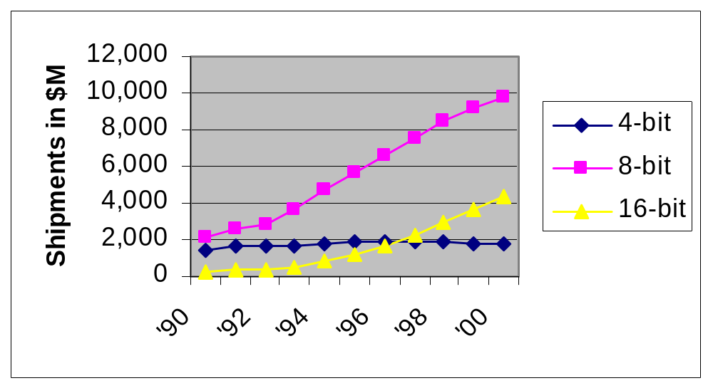
Microcomputer market
PC’s are 1% of all processors sold
Embedded processors outsell desktop by 99%
Notes:
Note that this is a bit of apples and oranges comparison. The % is number of units sold. The graph is dollars. If you count the cost of the box the processor is in though you would need to take into account the automotive market.

Slide 5
Intro to computer organization
Most processors today are von Neuman
  single locus of execution
  program and data in same storage
Use a non-commercial 4 bit machine-GNOME2
  Simple instruction set - 16 vs 8051’s 255
  Accumulator based architecture - like 8051
  No input/output subsystem
  Easy to construct from scratch in an FPGA

Slide 6
Another embedded application:
    void main(){
    unsigned int pc;
    char rom[2048] = (0,1,2);
    char ir;
    pc = 0;
    while(1){
    ir= rom[++pc];
    switch (ir)
    {case 0: nop(); break;
    case 1: add(); break;
    /*...*/
    }}}

Slide 7
GNOME2 Microprocessor
write
8
data
CU
rd_data
IR
4
8
4
1
abus
bbus
15
addr
0
jump_pc
C
alu_op
7
ALU
1
Z
PC
0
+1
ACC
Notes:
This is the GNOME2 block diagram. Registers include the four bit ACC, eight bit IR, seven bit PC, the C and Z flag bits, and the current state register inside the control unit. IR is the instruction register, ACC is the accumulator, and PC is the program counter. The rest of the logic is combinational and includes the addr and PC multiplexors, control unit next state logic, PC incrementer, and the arithmetic and logic unit (ALU). The data bus (dbus) is bidirectional and is driven by GNOME2 when the write signal is asserted. When write is not asserted, GNOME2 may assert output enable (not shown) to enable external ram, rom, or I/O to drive the data bus.
This block diagram did not just appear out of thin air. It is a fairly typical example of an accumulator based architecture and is normally obtained after careful study of the proposed instruction set and several iterations. A course in computer organization typically spends a fair amount of time developing block diagrams like this and comparing various alternative designs.

Slide 8
Homework
See website for assignment
Due next Wednesday (1/24/2001)

